Slide 1
The TOGETHER Adaptive Platform Trial

Slide 2
Disclosure
Cytel
FTX Foundation
FastGrants
Rainwater Charitable Foundation
Bill & Melinda Gates Foundation
Eiger Biosciences
Lumen Sciences

Slide 3
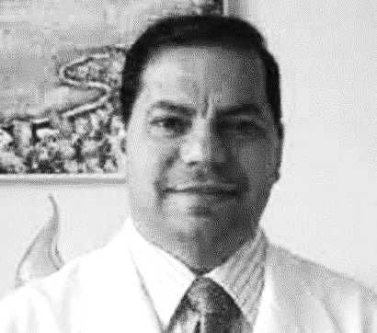
Chief Investigators
Dr. Gilmar Reis
Associate Professor
Division of Medicine
Pontificia Universidade Catòlica de Minas Gerais
Dr. Edward Mills
Professor
Health Research Methods, Evidence, and Impact
McMaster University

Slide 4
Healthcare is a cognitive field
We are all subject to cognitive bias
We are (usually) born Bayesians
Guidance may exist to reduce our cognitive bias, but does this work?
How often are we willing to admit we don’t know something in healthcare?
Some of us are unwilling to change our minds (ego is the enemy)
Group think permeates guideline development
Systematic reviews
The influence of marketing effects us all
People in healthcare judge themselves as superior to many others

Slide 5
COVID-19 tested those cognitive limits
When COVID-19 first occurred, what was your reaction?
How long did you really think the lock-downs would last?
How confident were you that science would find solutions?
Would those solutions come from industry, academia or government?

Slide 6
What we don’t know (and when we are willing to admit it)
COVID-19 is a poorly defined disease
The stages of disease are still not well defined
The greatest risk factors are still debated
What should you measure in a clinical trial or economic evaluation?
Where should you do your trials?
How open are you to information from cultures you don’t understand?

Slide 7
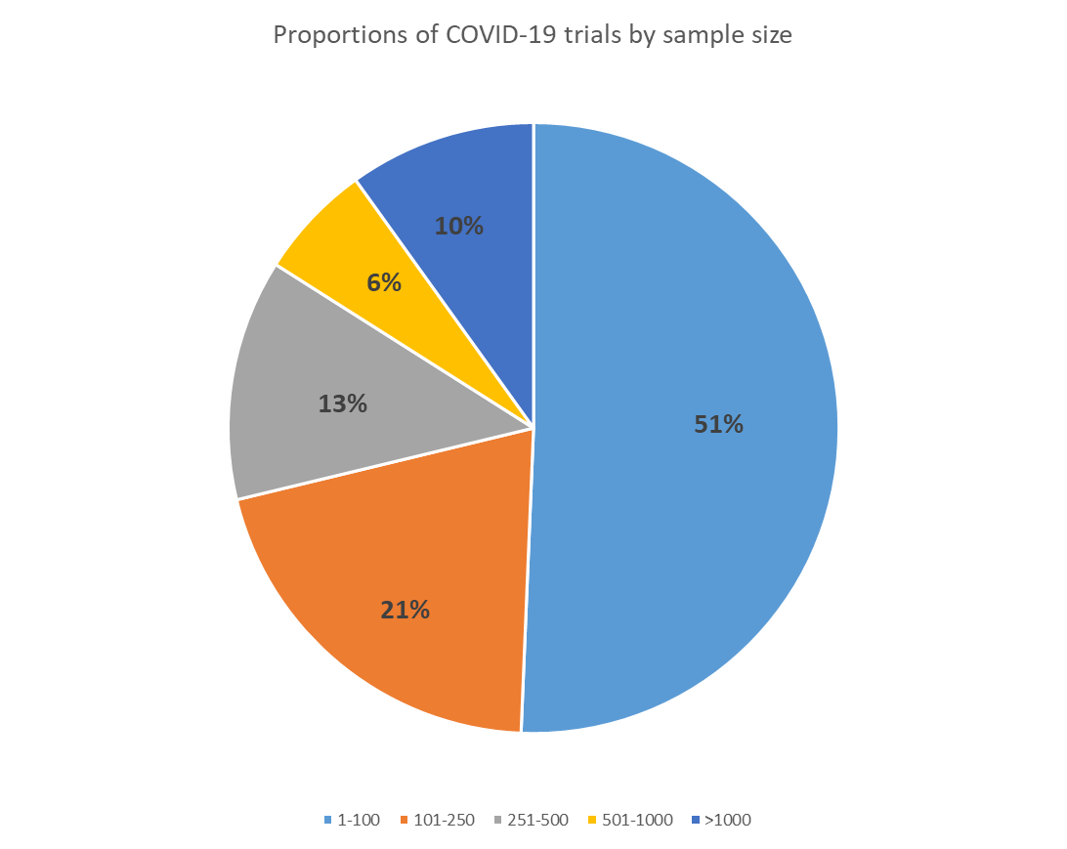
Clinical trials in COVID-19 are small,
and likely underpowered
Of the 2,908 trials captured in our registry, over half (51%) intended to recruit 100 patients or less.
The median sample size across all trials is 100

Slide 8
COVID-19 forced innovation in research
Adaptive designs for randomized trials
Particularly platform trials
Acceptance of Bayesian analysis for primary outcomes
Probability driven
Perpetual trials
Interim analyses and stopping early

Slide 9
What makes useful trials different?
Remap-Cap (international)
Solidarity (International)
Recovery (UK)
Principle (UK)
TOGETHER (Brazil)

Slide 10
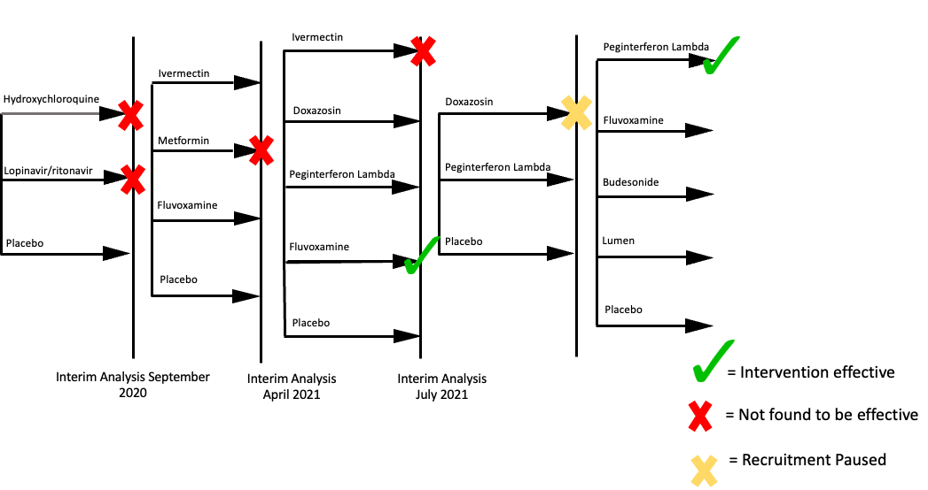
Platform Adaptive Trials

Slide 11
Highly Efficient Clinical Trials
Know your epidemic (power)
Model expected and unexpected measurements in trials (simulations)
Be open to change (adaptive)
Have a plan for what comes after you have answered your primary question (perpetual trials)
Leave a footprint (education)

Slide 12
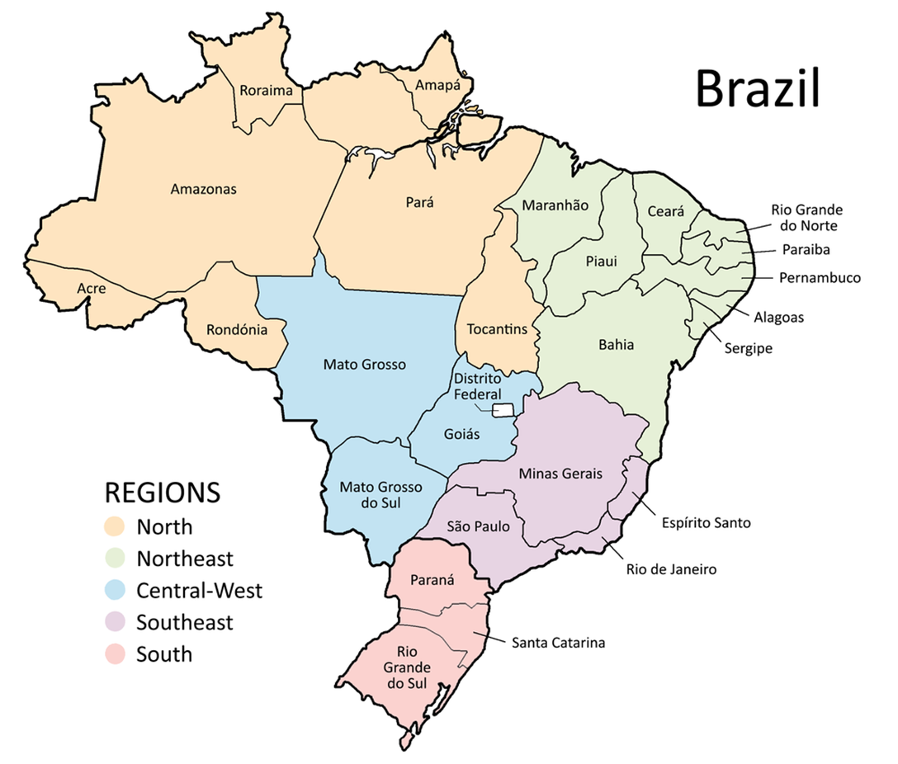
Trial Setting
Clinical Sites In Minas Gerais:
Sete Lagoas
Ibirité
Brumadinho
Governador Valadares
Montes Claros
Nova Lima
Santa Luzia
Ouro Preto
Belo Horizonte
Betim
Santa Casa de Misericórdia Sabará
Igarapé

Slide 13
Inclusion Criteria
Patients over the age of 18
Presenting to an outpatient care setting with an acute clinical condition consistent with COVID-19 and symptoms beginning within 7 days of the screening date
Positive rapid test for SARS-CoV-2 antigen
At least one additional criterion for high-risk

Slide 14
Statistical approach
Bayesian model for primary outcomes
Bayes models are driven by probabilities, not thresholds of significance
Decisions to stop, proceed, or make changes by a blinded DSMB

Slide 15
Intervention Timeline
Fluv SpO₂ < 94%
Fluv + Bud
INF-Lambda★
Doxazosin
Fluvoxamine²
IVM (low dose)
IVM (high dose)*
Metformin³
HCQ¹
LPV/r¹
Placebo
June 2020
October 2020
March 2021
July 2021
January 2.022
June 2021
September 2021
January 2021

Slide 16
Composite Outcomes
Admission to hospital care
Primary Outcomes:
COVID-19 emergency hospital visits due to the clinical worsening of COVID-19 (defined as participant remaining under observation for > 6 hours)
Hospitalization due to the progression of COVID-19 (defined as worsening of viral pneumonia) and/or complications within 28 days of randomization.
Secondary Outcomes:
WHO clinical worsening scale
PROMIS global health scale
Mortality defined and all-cause
Cause-specific hospitalization
Viral clearance and viral load
Respiratory symptoms
Adverse events
Adverse drug reactions
Adherence with medication

Slide 17
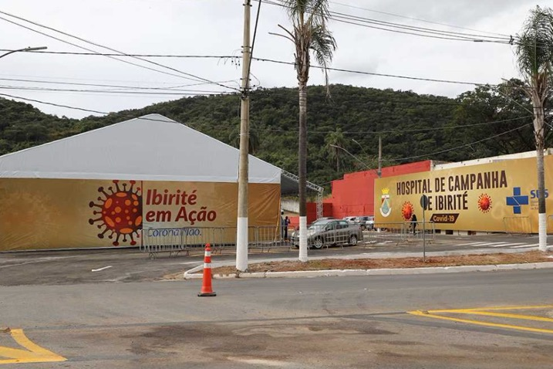
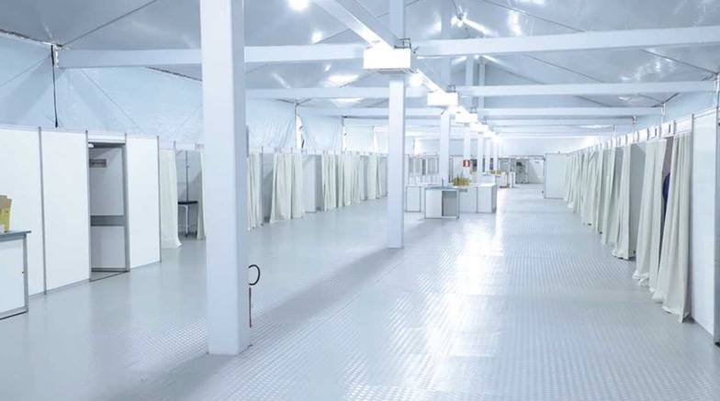
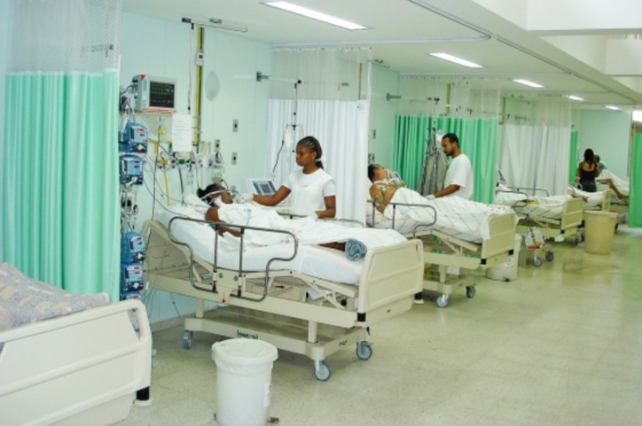
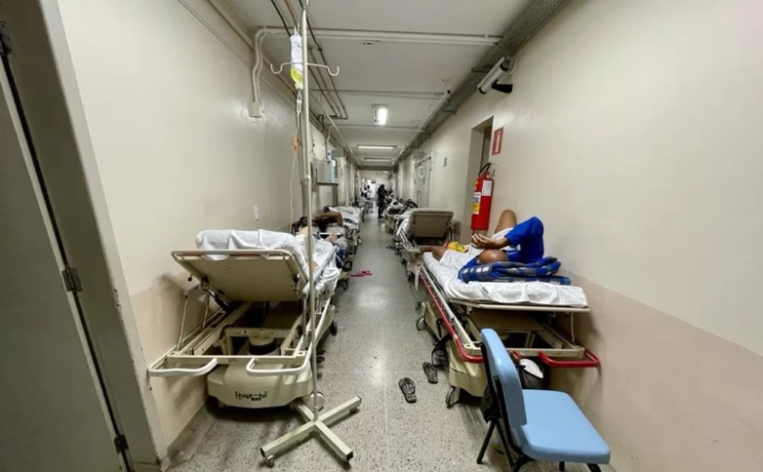

Slide 19
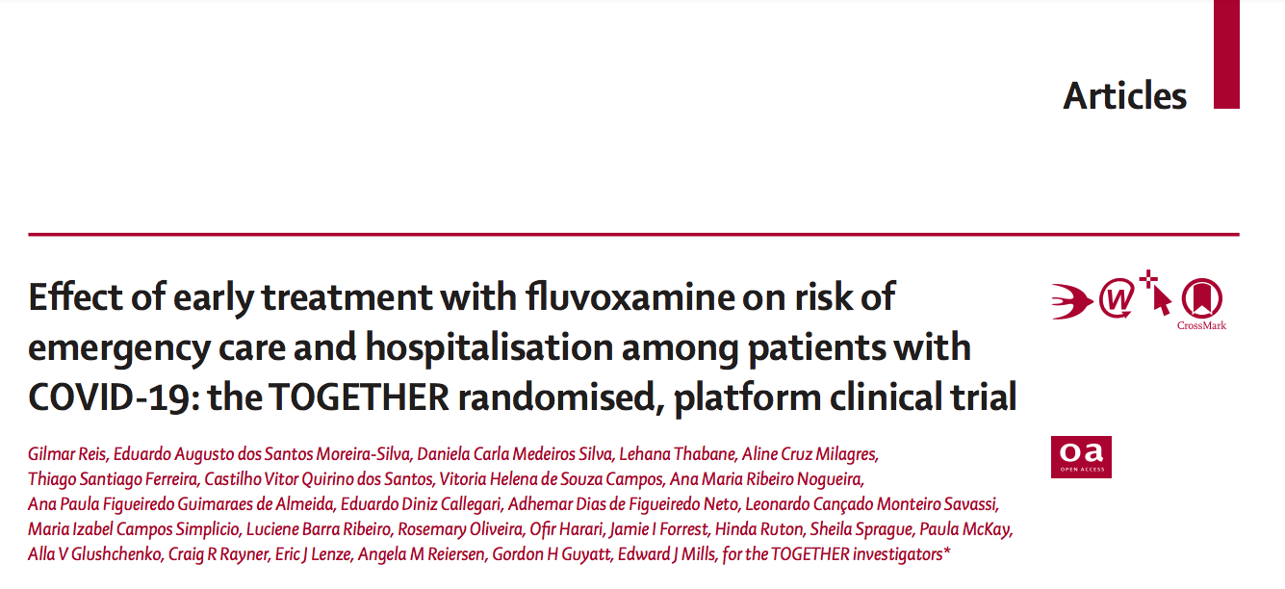

Slide 22
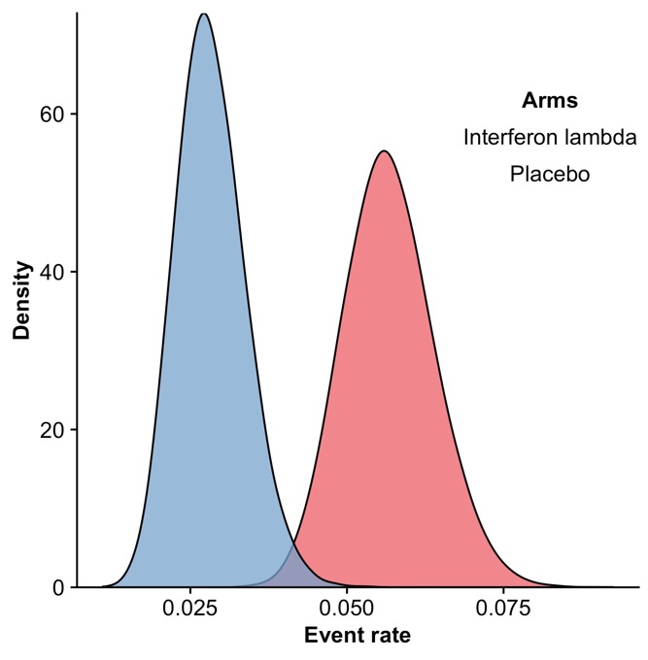
Lambda Highly Superior Compared to Placebo
99.91% PROBABILITY OF SUPERIORITY, SURPASSING PRESPECIFIED SUPERIORITY THRESHOLD OF 97.6%
Risk | Lambda n=916 | Placebo n=1020 | Risk Reduction (95% BCI) | Probability of Superiority*
Hospitalizations or ER visits | 25 (2.7%) | 57 (5.6%) | 50% (23 - 69%) | 99.9%
Hospitalizations | 21 (2.3%) | 41 (4%) | 42% (5 - 66%) | 98.4%
2.7%
POSTERIOR
DISTRIBUTION
5.6%
Probability of Superiority
Lambda | PBO
99.91 | 0.09
1 death in Lambda group; 4 deaths in Placebo group
84% patients were vaccinated
Incidence of any adverse event was indistinguishable between Lambda and Placebo group
PBO
LAMBDA
Statistical analysis conducted in a Bayesian framework
Prespecified Threshold of Superiority = 97.6%

Slide 23
Current interventions
Fluoxetine plus inhaled budesonide
Fluvoxamine plus budesonide

Slide 24
Unexpected challenges
Decision-making is a cognitive process
Infectious disease community doesn’t understand clinical trials well
Guideline committees are run by systematic review groups
Individuals, including guideline groups, are influenced by marketing
Funders don’t make serious investments in clinical research
Where is Canada in all of this?

Slide 25
Lessons for the future
COVID-19 pushed innovation
Collaboration doesn’t occur where egos dominate
Most people working in healthcare have only a basic knowledge of research
There is an overt cultural bias in healthcare decision-making
Yet we have more to learn from other cultures than they do from us
Adaptive approaches to research and Bayesian thinking will be the future
But they risk being co-opted and that may be worse

Slide 26
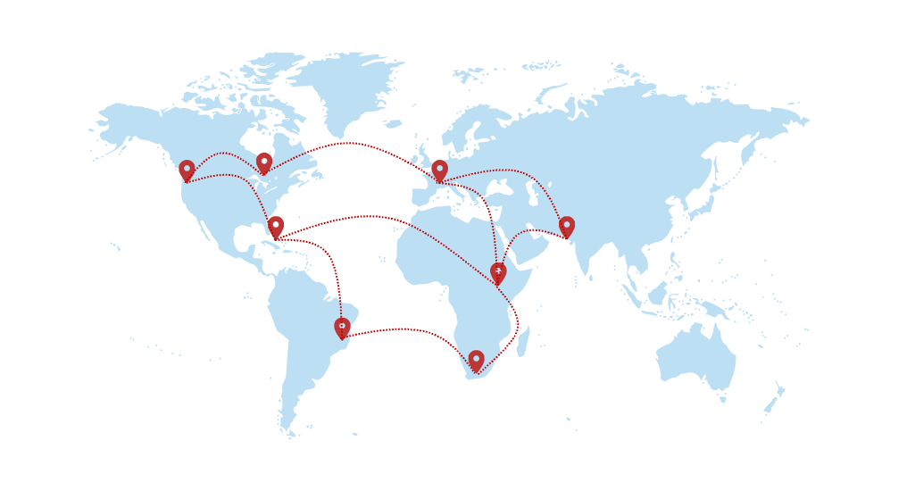

Slide 27
Global anti-viral basket trial (RELIEF)

Slide 28
If you want to go fast, go alone If you want to go far, go TOGETHER

Slide 29
Support

Slide 30
The TOGETHER Team
C0-Principal Investigators:
Edward Mills
Gilmar Reis
Data and Safety Monitoring Committee:
Kristian Thorlund (Chair)
Sonal Singh
William Cameron
James Orbinski
Jonas Haggstrom
Pharmacist:
Linèria Morais
Senior Investigators:
Craig Rayner
Eric Lenze
Gordon Guyatt
Lehana Thabane
Angela Reiersen
Communications:
Greg Thomas-Reilly
Veronica McGuire
Trial Management Group:
Eduardo Silva
Daniela Silva
Jamie Forrest
Cameron Chernecki
Sheila Sprague
Paula McKay
Aline Cruz Milagres
Thiago Santiago Ferraria
Castilho Vitor Quirino dos Santos
Adhemar Dias de Figueirdo Neto
Leonardo Cançado Monteiro Savassi
Maria Izabel Campos Simplicio
Luciene Barra Ribeiro
Rosemary Oliveira
Partner Institutions:
McMaster University
PUC Minas Gerais
University of Ottawa
Platform Life Sciences
MMS Holdings
Cytel Inc
University de Ouro Preto
Data Management:
James Bademian
Kathryne Scholtz
Mindy Wolf
Gerald Smith
Statistics:
Ofir Harari
Hinda Ruton
Holly Bailey

